Slide 1
Restaurant Closures: Project Update
Cole Smith

Slide 2
Recap
Objective is to predict
whether or not a restaurant will close within a given period of time
Based upon factors like
Health Violations (type, frequency), Location (demographics, income), Cuisine Type, Restaurant Type (restaurants vs. sidewalk cafes), and Economic Trends (DJIA, VIX)

Slide 3
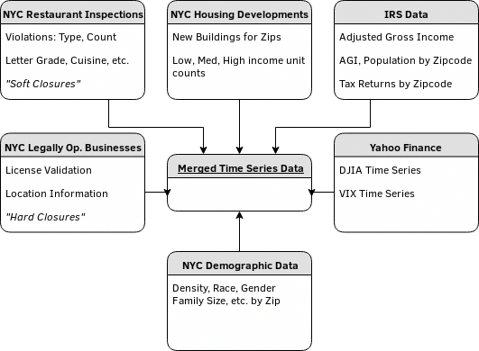
Data Sources

Slide 4
Initial Findings
Two Types of Closures
  Hard Closures: License expired and not renewed, cannot legally operate
  Soft Closures: Health Inspection shutdown, may re-open at some point
Hard closures appear related to soft closures on monthly aggregations
The type of violation and violation ratio appear most predictive so far

Slide 5
Current Issues
Data extremely imbalanced (5% closure rate)
  Estimators perform poorly
  Bootstrap Sampling, Downsampling: Estimators perform well but over-fit (lack of specificity)
Tables cannot be merged into restaurant-row format
  No common ID, cannot fuzzy join on names
  Only common key is date
Tables instead merged into closure-count on monthly timescale

Slide 6
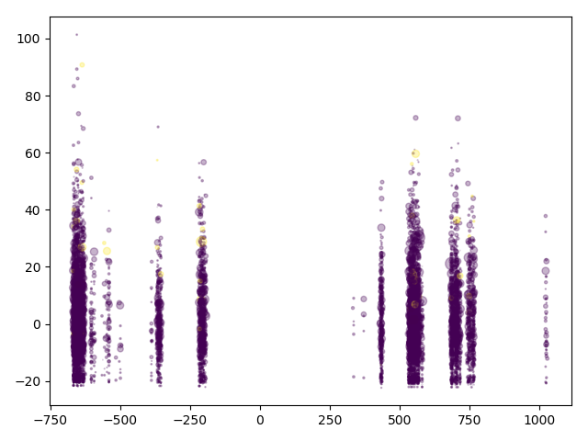
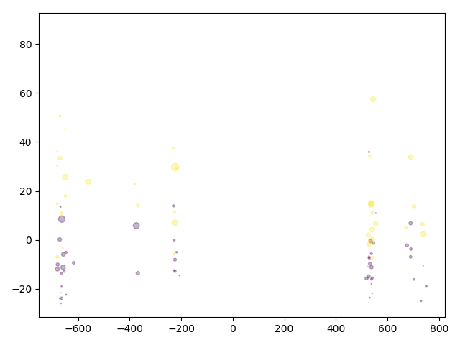
Modeling, Performance
Entire Set
Models can be built per data set and used as an ensemble
Best model on Restaurant Violations data set
  Gradient Boosting Machine (N=200)
  F1 Score: 0.65 on sub-sample
  0.1 on entire data set
Selective Down-Sample
– PCA –

